Slide 1
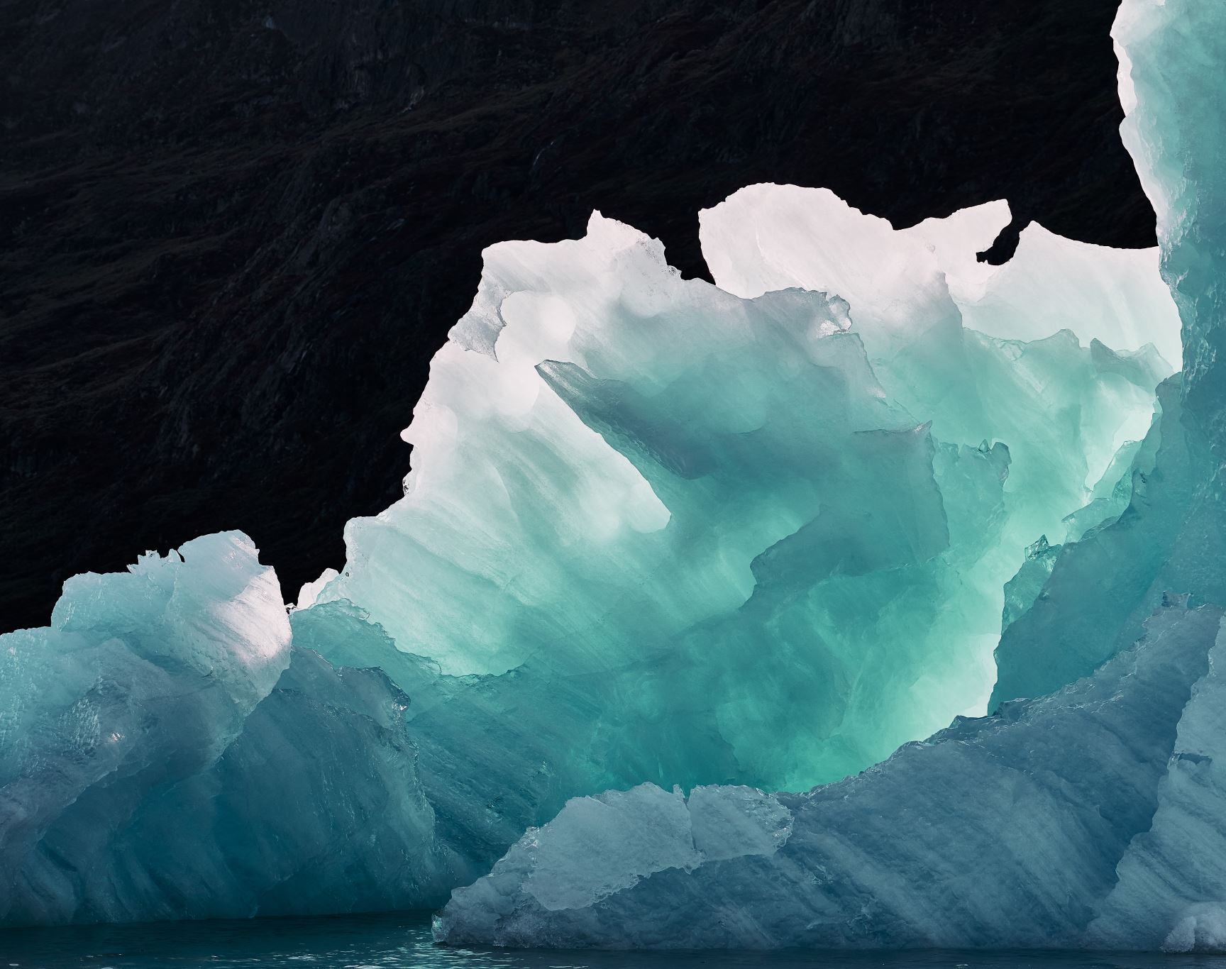
Ice Sheet Modeling and Optimization
Brief introduction to the problem and objectives

Slide 2
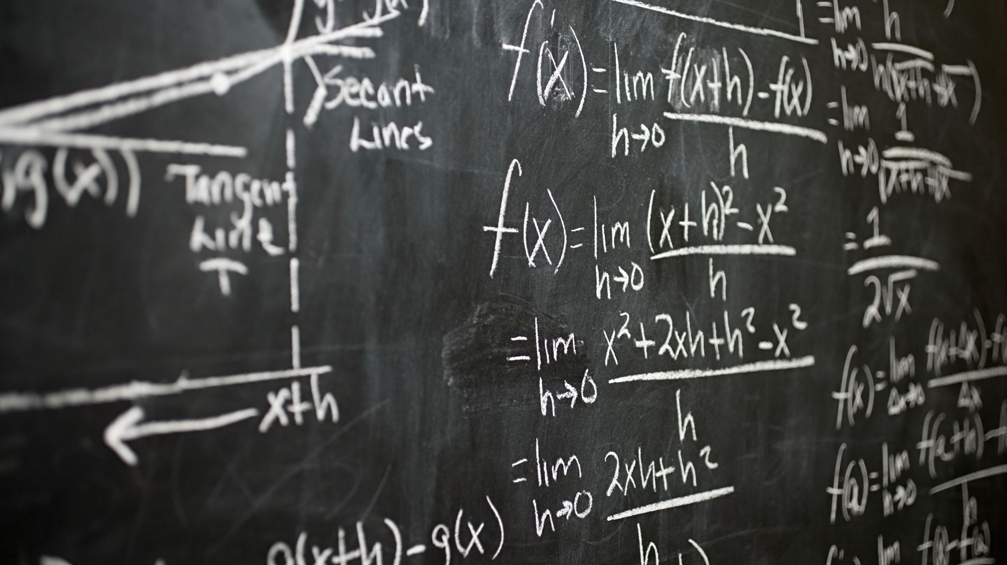
Background
Explain Full Stokes equations, Shallow Ice Approximation, and the nonlinear relationship between thickness (H) and mass balance function (a(x)).

Slide 3


Task 1
Objective function to minimize: $H\left(x\right)={\left(a\left(x\right)\left(−\frac{n+2}{2A}\right){\left(ρg\right)}^{−n}{\left|\frac{ⅆh}{ⅆx}\right|}^{1−n}{\left|\frac{ⅆh}{ⅆx}\right|}^{−1}\right)}^{\frac{1}{n+z}}$
$Error funtion: f(x)={\left\|H\left(x\right)−H_{obs}(x) \right\|}_{2}^{2}$
Provided rate factor: $A={10}^{−25}$
N that minimizes the objective function, using fminunc: n= 2.7633

Slide 4
Task 2
Use the value of n you find in Task 1, try to find A to minimize f. Did you get a different A value than 10−25?
A = 1.0064e-26

Slide 5
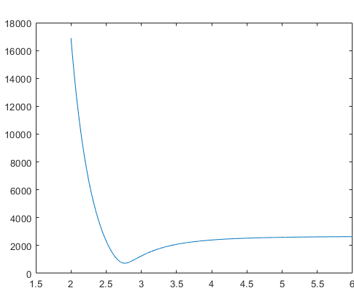
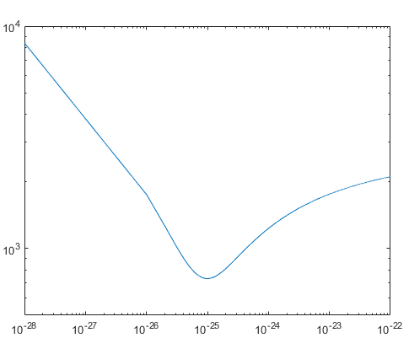
Visualization of the objective functions

Slide 6

Task 3
Change the initial guess in Task 1 and 2, redo the tasks. Do you get different optimal solutions?

Slide 7

Task 4
It is also possible to find A and n with the given data at the same time. Try to modify your code to find the optimal values for A and n. Take A = 10−25 and n = 1.1 as an initial guess.
n = 62.9049
A = 1e-306.740

Slide 8
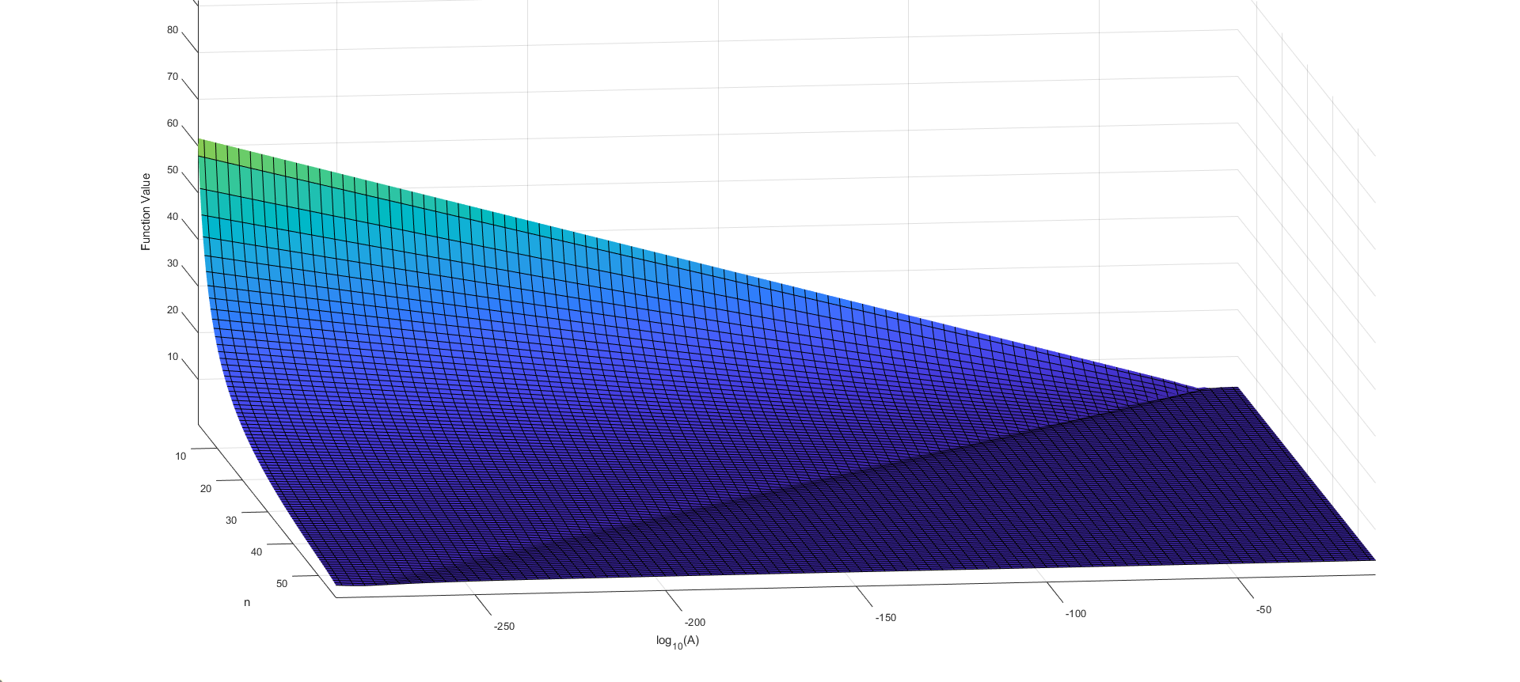
Surface graph of the objective function

Slide 9

Task 5
Redo Task 4 with some other initial guess. What can you say about your result
in Task 4? Which result from all these tasks is the optimal solution?

Slide 10
Task 6
Is it possible to do task 1 and task 2 iteratively to find the optimal solution for both A and n?
Possible, solution using lsqnonlin after forming non-linear least squares problem
Lsqnonlin using Levenberg-Marquardt

Slide 11

Task 7
$H_{i}(x)={\left(a_{i}\left(x\right)\left(−\frac{n+2}{2A}\right){\left(ρg\right)}^{−n}{\left|\frac{ⅆh}{ⅆx}\right|}^{1−n}{\left|\frac{ⅆh}{ⅆx}\right|}^{−1}\right)}^{\frac{1}{n+z}}$
Error: $f(x)={\left\|H_{i}(x)−H_{i}^{obs} (x) \right\|}_{2}^{2}$
Same results as in Task 4.

Slide 12

Conclusion
Summarize findings and highlight optimal solutions obtained.

